Slide 1
SACRED HEART DEGREE COLLEGE SITAPUR
MAA COSMATICS & BANGLE STORE
Presented to : Presented By:
Prachi mam KASHISH PATWA
BBA 1ST

Slide 2
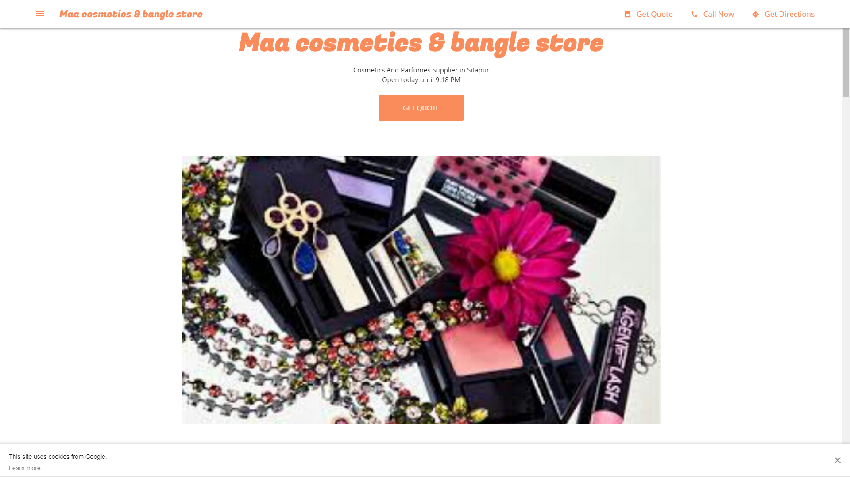

Slide 3
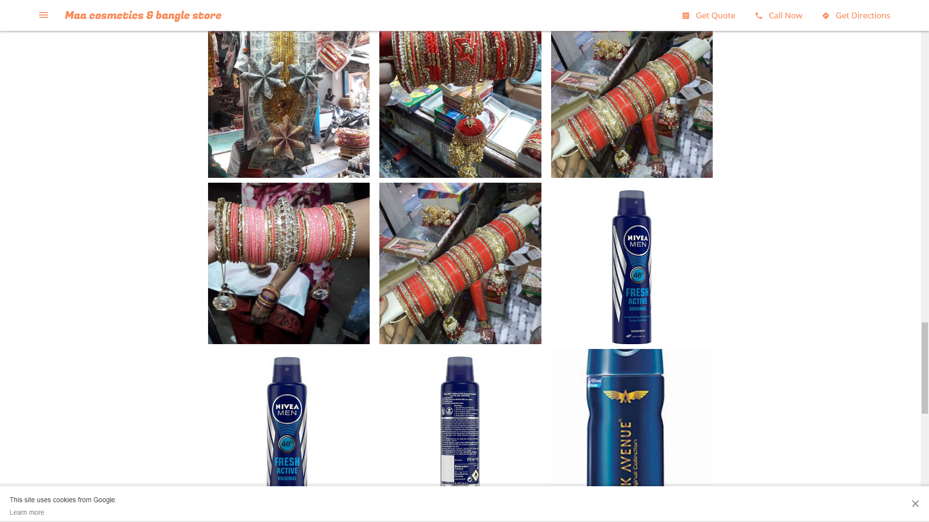

Slide 4
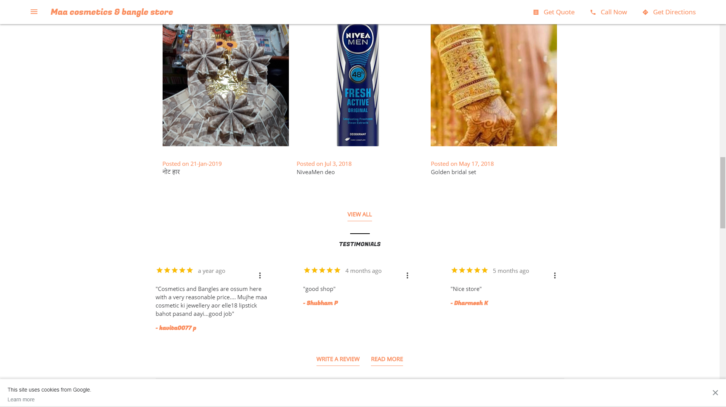

Slide 5
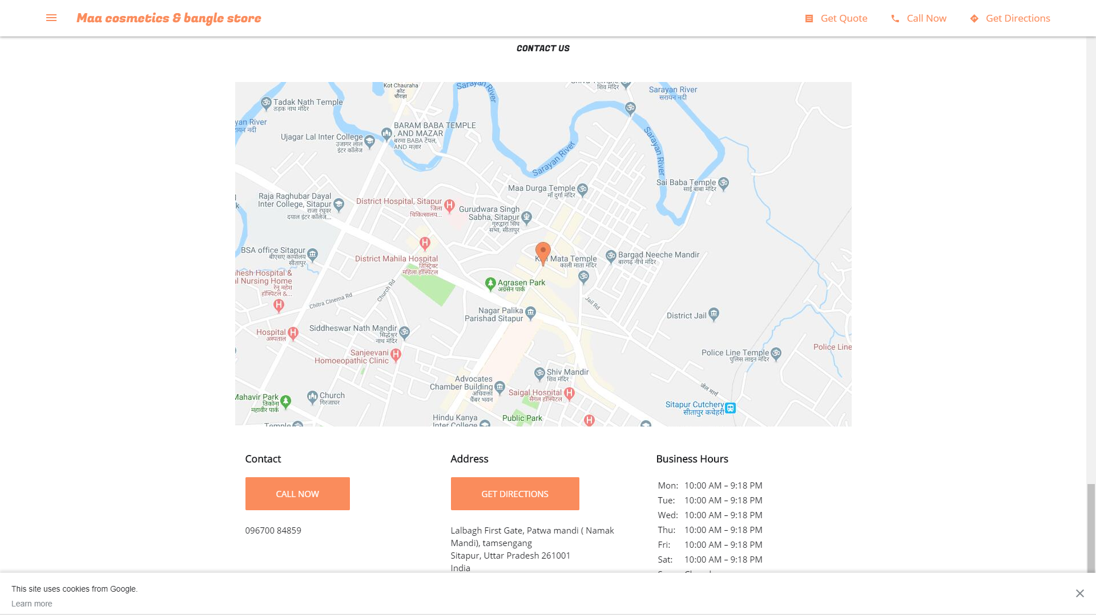

Slide 6
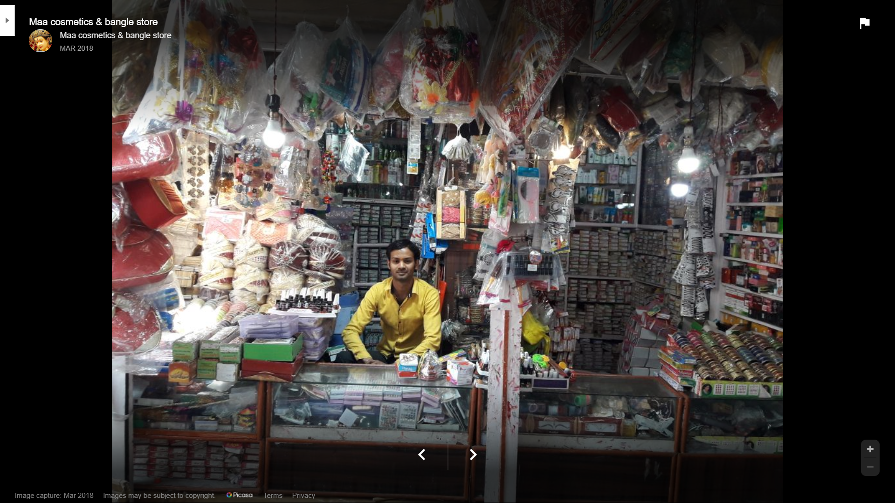

Slide 7
INTRODUCTION
Store is where retailers system & procedures come in contact with customers.
Operation management is managing of balance between things:
• Meeting customer needs
• Managing resources
Store operations management is all about demand & supply

Slide 8

STORE MANAGEMENT
Store Operations Management
Store Design : Interior & Exterior
Customer services
Store Profitability
Retail Display
MAA COSMATIC STORE
Mr. VIKRAM PATKAR
OWNER

Slide 9
FUNCTIONS OF STORE MANAGEMENT
1. To receive raw materials
2. To provide proper storage and preservation
3. To meet the demand of the consuming departments
4. stock accumulation

Slide 10
PROCEDURE IN STORE MANAGEMENT
❖ Store records: accurate & up-to-date store records must be maintained.
❖ Receipt of stores: proper delivery of items along with receipts.
❖ Issue of stores : stores should be issued on first in first out basis.
❖ Independent stock checks : regular stock checking by officer

Slide 11
ELEMENTS OF INTERIOR & EXTERIOR DESIGN
INTERIOR
EXTERIOR
i. FIXTURES
ii. DISPLAYS
iii. COLOUR
iv. LIGHTING
v. CEILINGS
vi. SHELVING
i. SIGNS
ii. RESTRICTIONS
iii. WINDOWS
iv. THEFT PREVENTION
v. MULTIPRODUCT STORES
vi. STORE NAME

Slide 12

Process of Store Operation Defined as principles, processes and procedure of operating a store.
Inventory & Stock Management
Customer Service
Transaction Handling & Administration
Store
Atmosphere & Space Management

Slide 13
SOME PRODUCTS STORE INCOME CHART
COMPANIES | PRODUCTS | MONTHELY SALES | YEARLY SALES
HINDUSTAN UNILIVER LTD | LAKEM’E , ELLE18,FAIR & LOVELY,DETTOL | 40,000 | 4,80,000
DABUR | OIL,SOAP,BELEACH | 20,000 | 2,40,000
PATANJALI | FACEWASH ,THOOTH PASTE , SOAP , GHEE | 60,000 | 7,20,000
NIVEA | DIO , CREAM , POWDER , FACEWASH , BLEACH | 15,000 | 1,80,000
HIMALAYA | FACEWASH , SOAP , FACEPACK | 10,000 | 1,20,000
BAJAJ | OIL , | 10,000 | 1,20,000

Slide 14


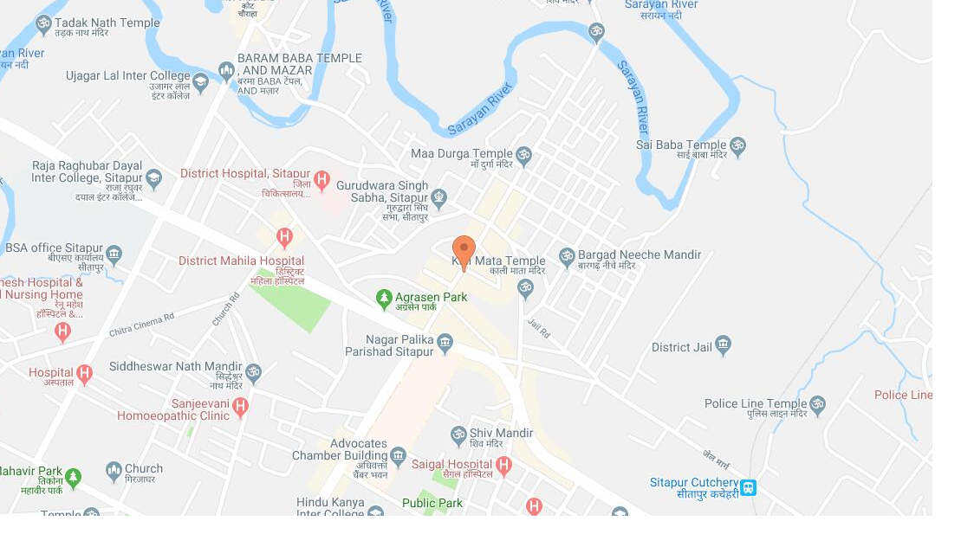
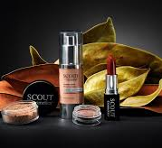

5 STEPS TO DEVELOP MARKETING STRATEGIES
Start researching customers , leads and prospects
Determine a social media Strategy to drive traffic.
Map your content marketing strategy to your audience
List the benefits your product or services deliver
Clearly identify your ideal customers problem’s

Slide 15
Thank You

